Slide 1

Identifying the Right Data
Strategies, Methods, and Impacts

Slide 2
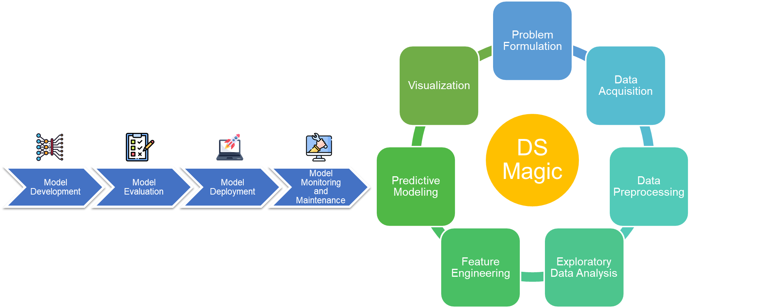
The Right Data.
What kind of data?
Data which is relevant, accurate, and suitable for your specific goals and analysis.

Slide 3





Characteristics of the Right Data
Relevance
How is the data related to the research question or problem statement?
Accuracy
Is the data free from errors, mistakes, or inconsistencies.
Completeness
Does the data include all relevant information without any missing values?
Consistency
Is the data uniform and follows a standardized format or structure?
Reliability
Can the data be trusted and depended upon for analysis and decision-making?

Slide 4
How can we identify the right data?
Step 1: Define clear objectives
Step 2: Literature review
Step 3: Consultations with domain experts

Slide 5
Step 1: Define clear objectives
In marketing
In healthcare
In finance
To understand the factors influencing customer purchasing decisions and develop targeted marketing strategies.
To examine the effectiveness of a new treatment method in reducing patient recovery time.
To predict stock market trends and identify profitable investment opportunities.
Provide clear direction and purpose for data collection and analysis.
Help identify the specific types of data needed to address the research questions or problems.

Slide 6
Step 2: Literature Review (1/2)
Reusability!
a thorough literature review can identify many relevant data sources.
Example:
"To assess the impact of climate change on global ecosystems and inform conservation strategies."

Slide 7
Step 2: Literature Review (2/2)
Global Temperature Records:
Datasets that provide historical temperature records from various regions across the globe.
Examples: NOAA Global Historical Climatology Network (GHCN) and HadCRUT4.
Carbon Emission Datasets:
Datasets that quantify greenhouse gas emissions, such as carbon dioxide (CO2) or methane (CH4).
Examples: Global Carbon Project and Emissions Database for Global Atmospheric Research (EDGAR).
Climate Models:
Simulation models that project future climate conditions based on different emission scenarios.
Examples: Coupled Model Intercomparison Project (CMIP) and Community Earth System Model (CESM).
Biodiversity Datasets:
Datasets that document species distributions, population trends, and habitat changes.
Examples: International Union for Conservation of Nature (IUCN) Red List and Global Biodiversity Information Facility (GBIF).
Remote Sensing Data:
Satellite imagery or aerial photographs that capture changes in land cover, vegetation, or ice extent.
Examples: NASA Earth Observing System Data and Information System (EOSDIS) and European Space Agency Climate Change Initiative (ESA CCI).
Oceanographic Data:
Datasets related to sea surface temperature, ocean currents, salinity, and acidification.
Examples: National Oceanic and Atmospheric Administration (NOAA) National Centers for Environmental Information (NCEI) and Integrated Marine Observing System (IMOS).
Notes:
References:
NOAA Global Historical Climatology Network (GHCN). Retrieved from https://www.ncdc.noaa.gov/data-access/land-based-station-data/land-based-datasets/global-historical-climatology-network-ghcn
HadCRUT4. Retrieved from https://crudata.uea.ac.uk/cru/data/temperature/
Global Carbon Project. Retrieved from https://www.globalcarbonproject.org/data.htm
Emissions Database for Global Atmospheric Research (EDGAR). Retrieved from https://edgar.jrc.ec.europa.eu/overview.php?v=booklet2020
Coupled Model Intercomparison Project (CMIP). Retrieved from https://www.wcrp-climate.org/wgcm-cmip
Community Earth System Model (CESM). Retrieved from http://www.cesm.ucar.edu/
International Union for Conservation of Nature (IUCN) Red List. Retrieved from https://www.iucnredlist.org/
Global Biodiversity Information Facility (GBIF). Retrieved from https://www.gbif.org/
NASA Earth Observing System Data and Information System (EOSDIS). Retrieved from https://earthdata.nasa.gov/
European Space Agency Climate Change Initiative (ESA CCI). Retrieved from https://www.esa-cci.org/
National Oceanic and Atmospheric Administration (NOAA) National Centers for Environmental Information (NCEI). Retrieved from https://www.ncei.noaa.gov/
Integrated Marine Observing System (IMOS). Retrieved from https://www.imos.org.au/

Slide 8

Step 3: Consultations with domain experts
Domain experts are individuals who possess specialized knowledge and experience in a specific field or subject area.
They can provide valuable insights, guidance, and recommendations throughout the data identification process.
Crucial to ensure the accuracy, relevance, and reliability of the obtained data.

Slide 9
How can we evaluate the quality of data?

Slide 10

Statistical Analysis Techniques (1/3)
Descriptive Statistics
Hypothesis Testing
Summarizing and describing the main characteristics of the data.
Assessing the significance of relationships or differences in the data.
Inferential Statistics
Regression Analysis
Drawing conclusions or making predictions based on sample data.
Examining the relationship between variables and making predictions

Slide 11
Statistical Analysis Techniques (2/3)
Mean (μ)
μ = (x₁ + x₂ + ... + xn) / n
Median
Mode
Variance (σ²)
σ² = Σ(xᵢ - μ)² / n
Standard Deviation (σ)
σ = √(Σ(xᵢ - μ)² / n)
Percentile
The mean is the average value of a set of numbers.
The median is the middle value in a sorted dataset.
If there is an even number of observations, the median is the average of the two middle values.
The mode is the value that appears most frequently in a dataset.
Variance measures the spread or variability of a dataset.
The standard deviation is the square root of the variance.
It represents the average distance between each data point and the mean.
A percentile indicates the value below which a given percentage of data falls.
The pth percentile divides the data into two parts: p% of the data lies below the pth percentile, and (100 - p)% lies above it.

Slide 12
Statistical Analysis Techniques (3/3)
Measure | What It Tells Us
Mean (μ) | Skewed by the outlier, not fully reliable alone.
Median | More reliable central tendency in presence of outlier.
Mode | Shows consistent values; data clustering.
Variance (σ²) | High spread—signals an outlier or inconsistent data.
Standard Deviation | Confirms significant deviation—need to clean data or analyze outliers.
90th Percentile | Shows extreme value that might distort the dataset if not explained/cleaned.

Slide 13
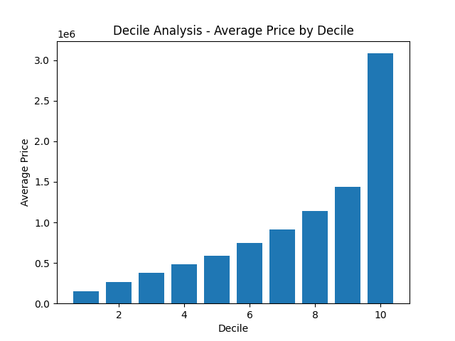
Decile Analysis
Split data in 10 parts (based on a specific metric)
Evaluate performance for each part.
Notes:
Each decile represents a distinct segment or group of data points.
It divides data into 10 equal parts (called deciles) after sorting based on a specific variable or metric.
Each decile represents 10% of the data.
For example:
1st decile (D1) = value below which 10% of data falls.
5th decile (D5) = median.
10th decile (D10) = maximum value.
Application and benefits of decile analysis in identifying the right data:
Decile analysis helps identify significant variations or patterns across different segments of the data.
It allows for targeted analysis and comparison of data subsets to uncover valuable insights or trends.

Slide 14
PDSA Cycle (Plan-Do-Study-Act)
Plan
Do
Study
Act
Set objectives, define data requirements, and plan the analysis.
Collect and analyze the data based on the defined plan.
Evaluate the results, identify areas for improvement, and refine data selection.
Implement changes, incorporate feedback, and repeat the cycle for iterative improvement.
Notes:
By continuously applying the PSDA cycle, organizations can improve the identification of the right data over time and enhance the quality of their analysis.

Slide 15
Delphi Method
Collects expert opinion using multiple rounds
Structured
Iterative process
Experts provide feedback anonymously and revise their opinions based on group consensus.
Notes:
Seek expert opinions on the relevance and suitability of data sources or variables.
Iteratively refine data selection based on expert consensus and feedback.

Slide 16
Data Triangulation
Combine multiple data sources or methods to enhance reliability and reduce biases.
Benefits
Increased validity
cross-validation of findings
comprehensive understanding.
Qualitative (Interviews)
Data Triangulation
Quantitative (Surveys)
Expert Feedback
Example of Data Triangulation
Notes:
Reduces reliance on a single source, minimizing the risk of incomplete or biased information.
Allows for cross-validation of findings, increasing confidence in the results.
Provides a broader perspective and a more comprehensive understanding of the subject under investigation.

Slide 17
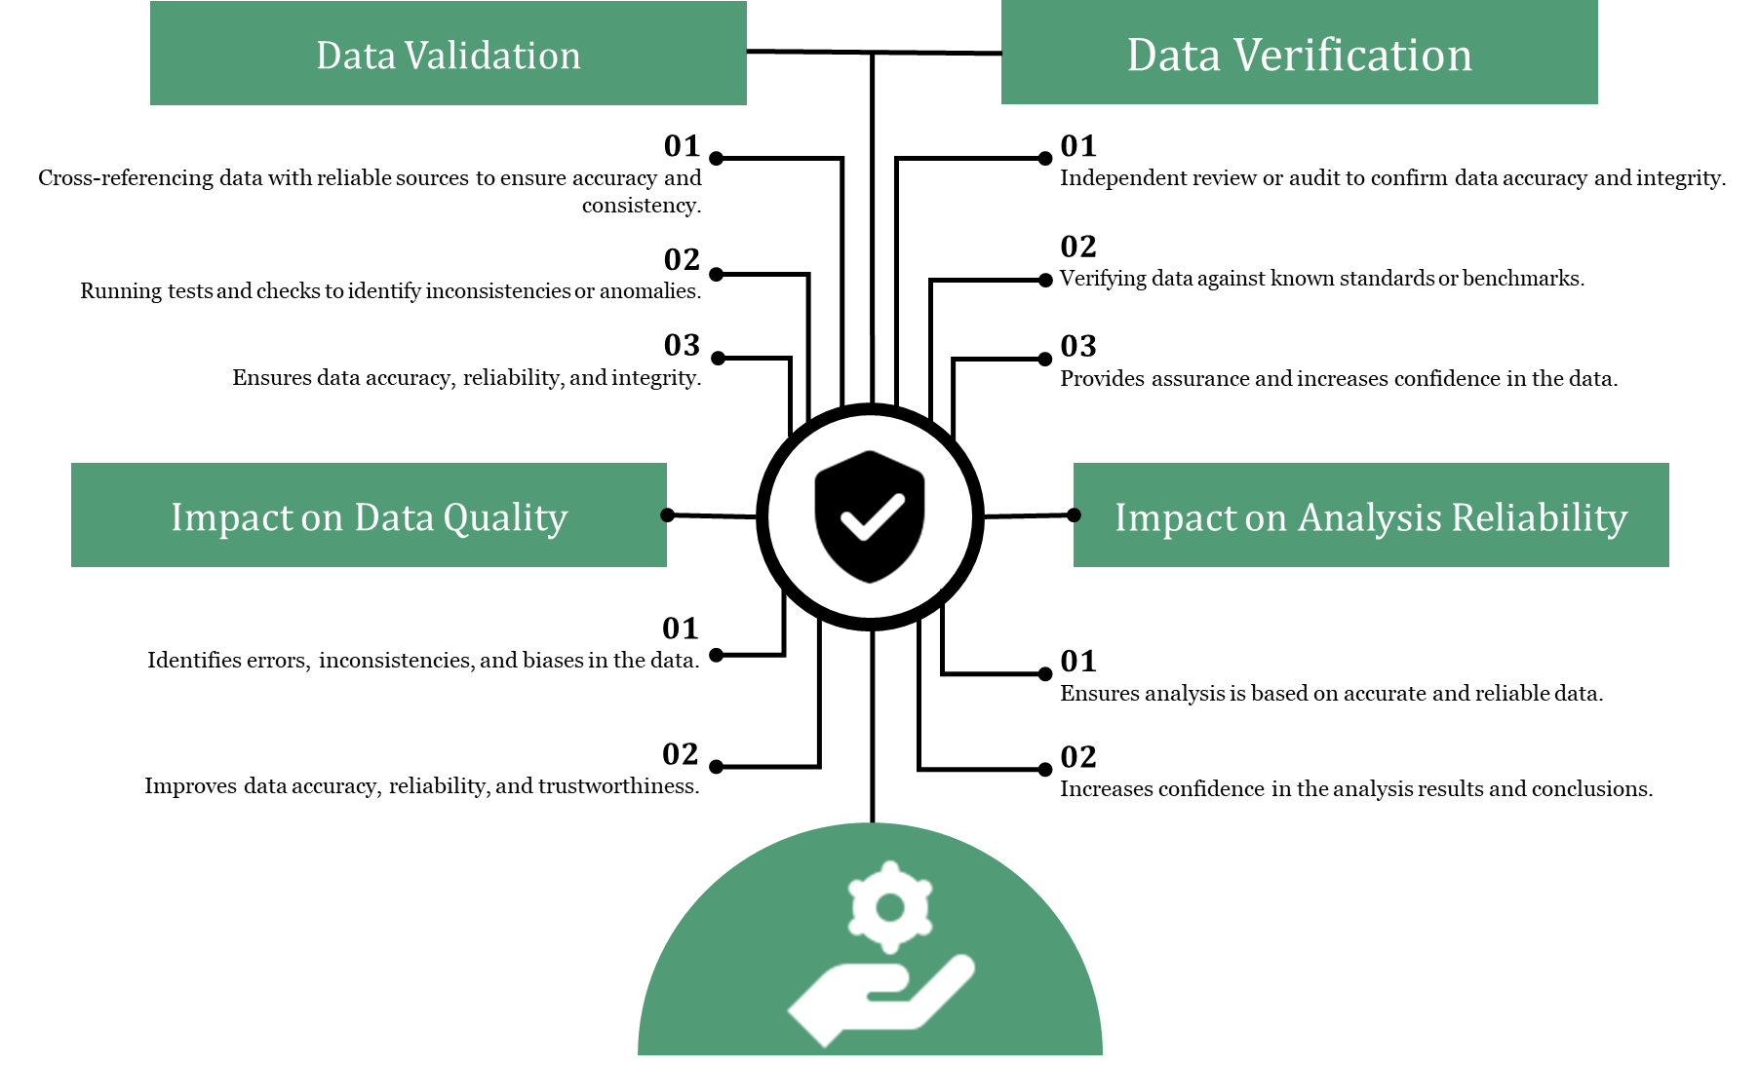
Data Validation and Verification

Slide 18
That’s a lot of work on a lot of data!

Slide 19
Sample Selection Techniques (1/4)
Random sampling
Selecting a subset of data randomly to represent the entire population.

Slide 20
Sample Selection Techniques (2/4)
Stratified sampling
Dividing the population into distinct groups and selecting samples from each group.
Notes:
In stratified sampling, the population is divided into subgroups or strata based on certain characteristics.
Samples are then selected from each stratum in proportion to its representation in the population.
It ensures that the sample represents the diversity of the population and allows for subgroup analysis.

Slide 21


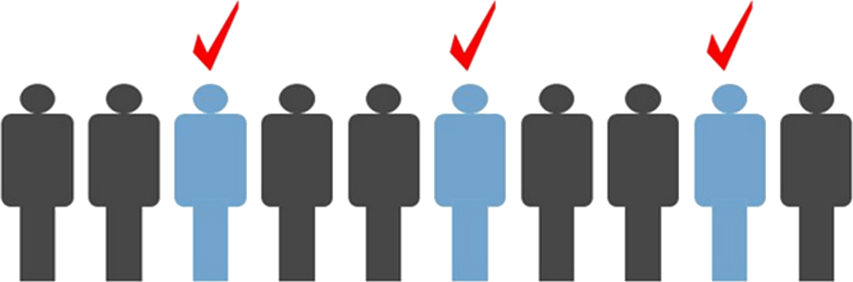
Sample Selection Techniques (3/4)
Cluster sampling
Create clusters(groups) in the data
Select a cluster
Use all instances in the cluster
Systematic sampling
Select a random data instance
Then select every nth element from data
Convenience sampling
Selecting instances/data sources which are readily available or easily accessible

Slide 22
Why are we doing this?

Slide 23
Impact of Right Data on AI/ML
Enhancing model accuracy and performance
Facilitating effective decision-making
Driving innovation and competitive advantage
Notes:
AI/ML models depend on high-quality data for training, validation, and testing.
The right data improves model accuracy, reduces bias, and enhances predictive capabilities.
Accurate and relevant data enables informed decision-making in AI/ML applications.
It provides valuable insights, supports trend analysis, and helps identify patterns or anomalies.
Organizations that leverage the right data gain a competitive edge by identifying market trends, customer preferences, and new opportunities.

Slide 24
Impact of Right Data on Business
Improved customer understanding and targeting
Enhanced operational efficiency and cost reduction
Data-driven innovation and product development
Notes:
Improved customer understanding and targeting:
The right data enables businesses to understand their customers better, including preferences, behavior patterns, and buying habits.
It supports targeted marketing strategies and personalized customer experiences.
Enhanced operational efficiency and cost reduction:
Accurate data enables process optimization, resource allocation, and inventory management.
It helps identify inefficiencies, reduce waste, and improve overall operational efficiency.
Data-driven innovation and product development:
The right data provides insights for innovation, product development, and market adaptation.
It helps businesses identify emerging trends, customer needs, and areas for improvement.

Slide 25
Wrong Data and its Impact
Incorrect insights
flawed conclusions
biased predictions
Inaccurate data
Example: Recording incorrect sales figures or customer details due to human error or technical glitches.
Incomplete data
Example: Missing fields in a customer database, such as contact information or purchase history.
Biased data
Example: Biased survey responses due to sampling bias or leading questions.
contains errors, mistakes, or false information.
lacks necessary information or has missing values.
reflects a particular viewpoint or is influenced by prejudice.

Slide 26
How do we obtain the right data?

Slide 27
Obtaining the Right Data
Surveys
Experiments
Observations from the real world
Existing databases, data providers, and open data sources
Other methods
Controlled experiments
Focus groups
Case studies
Ethnographic research
Questionnaires
Interviews
A/B testing

Slide 28
Assignment for Next Lecture
You need to write 1 1-page PROPOSAL for the Technical Report.
It could be on any topic of your interest.
Some topics could be virtualization Techniques, Security and Protection in modern operating systems, Authentication in smartphones, Internet of Things, and Smart Cities. Green computing, embedded operating systems, performance evaluation of modern operating systems. etc.
It could also be another topic, but you have to discuss it.

